Slide 1

Exploratory Data Analysis of Flight Price Prediction
PRESENTED BY:
Alekhya BOMMINENI
YASHWANTH THALLA
RUTHWIK Mamidala

Slide 2
Abstract
A comprehensive evaluation of three machine learning models : Linear Regression, Decision Tree, and Random Forest—on a preprocessed dataset to assess their performance. It includes exploratory data analysis (EDA) to identify patterns and anomalies, and data preprocessing such as handling missing values, scaling, and encoding. The models are compared using metrics like MAE, MSE, RMSE, and R-squared. The findings reveal that Decision Trees are highly accurate but prone to overfitting, Linear Regression is clear but limited by assumptions, and Random Forests provide a balanced accuracy and stability, making them robust for complex datasets.

Slide 3
Introduction
The study applies Linear Regression, Decision Trees, and Random Forests to a preprocessed dataset, assessing each model's performance through accuracy and error metrics. The goal is to determine which model performs best under different conditions and to provide insights into their suitability for specific tasks. This comparative analysis aims to help select the most appropriate modeling techniques, enhancing the effectiveness of predictive analytics in practical scenarios.

Slide 4
Dataset
Dataset used: Flight Price Prediction from Kaggle, including variables such as flight prices, durations, and booking patterns.
Dataset Link : Flight Price Prediction (kaggle.com)

Slide 5
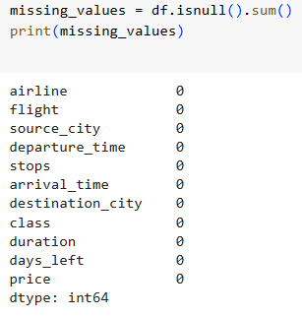
Preprocessing
Data cleaning steps included removing unwanted columns, changing data types, handling missing and duplicate values. Feature engineering involved normalization, scaling, and encoding.

Slide 6
Literature Review
The flight fare prediction project utilizing machine learning aims to forecast flight prices. A user interface was developed to facilitate the entire process, incorporating essential inputs such as arrival and departure dates, source, destination, and more. This project has successfully yielded a reliable and user-friendly system for predicting flight fares. Data was meticulously collected, preprocessed, and features were extracted from flight fare information. A robust random forest model was then trained and its performance evaluated. The web application created through this project empowers travelers to make informed decisions by providing predictions on flight prices based on their input.

Slide 7
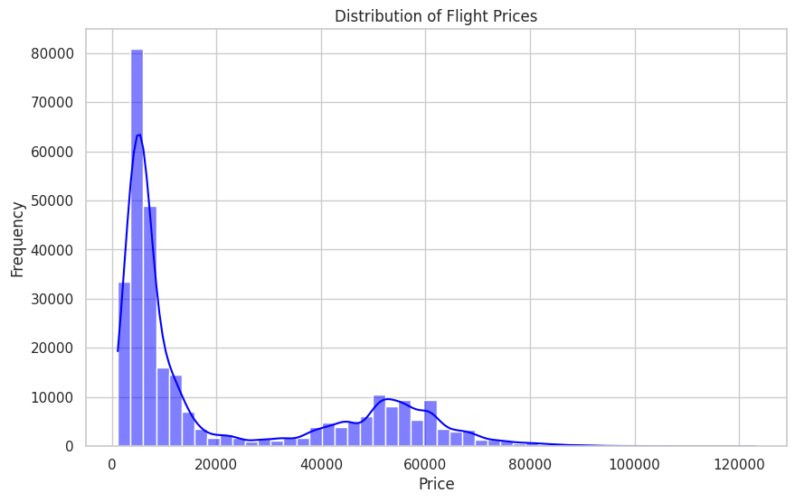
Data Distributions

Slide 8
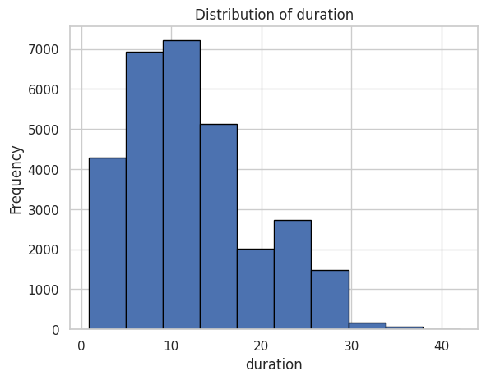
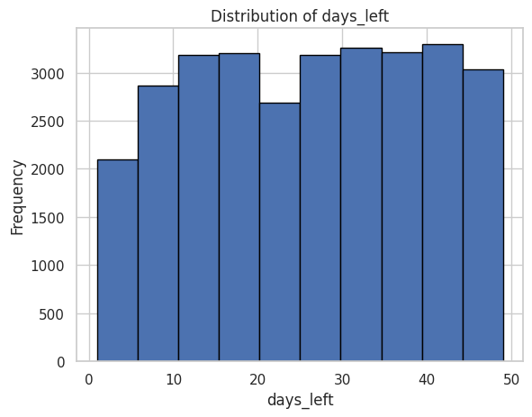
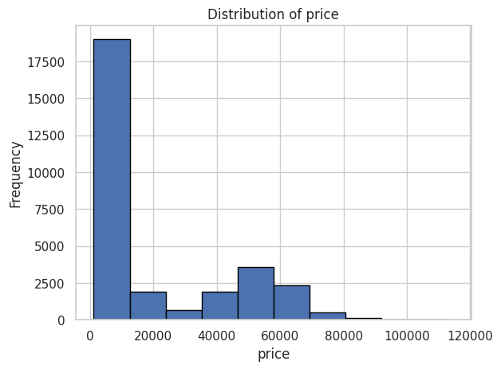

Slide 9
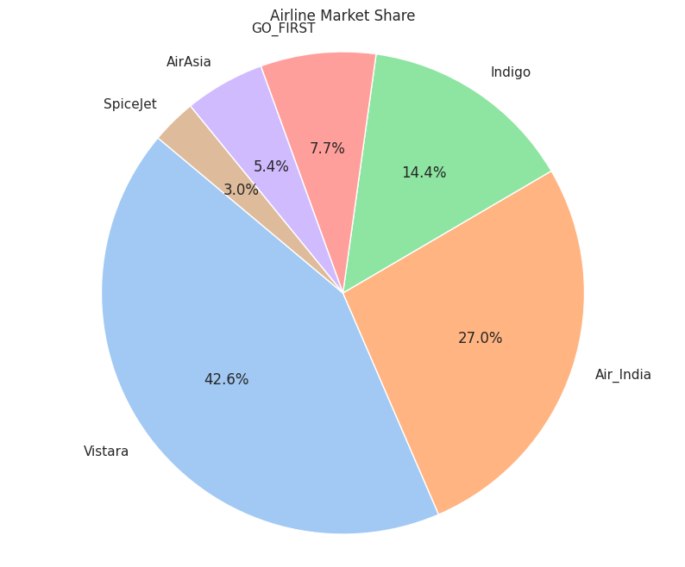
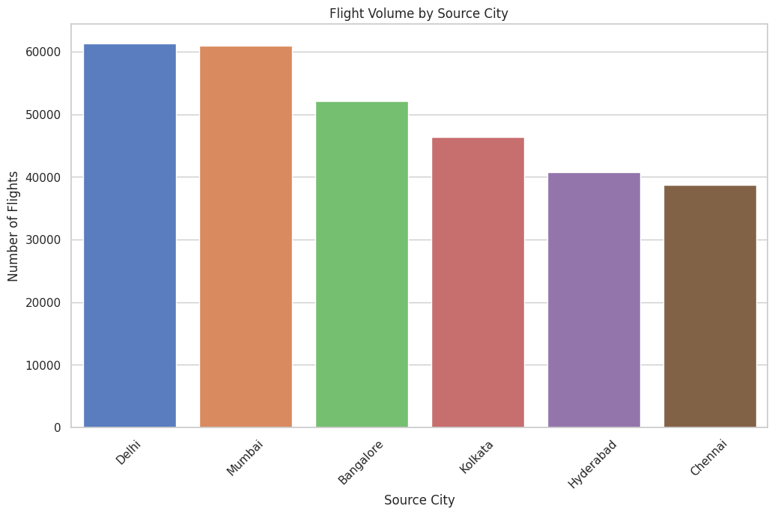

Slide 10
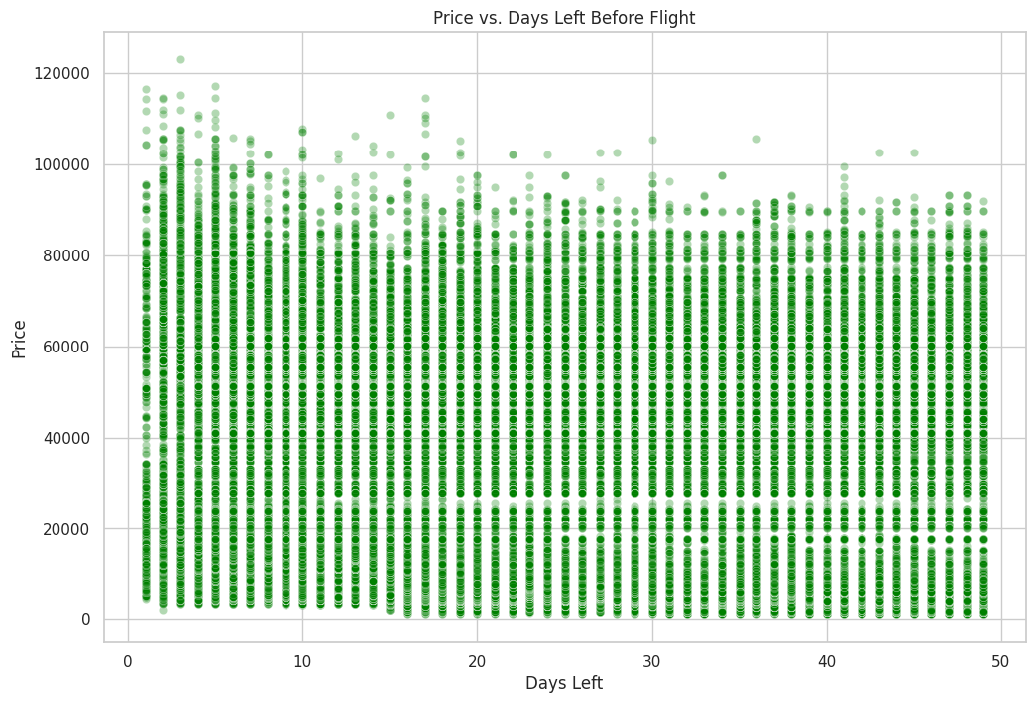

Slide 11
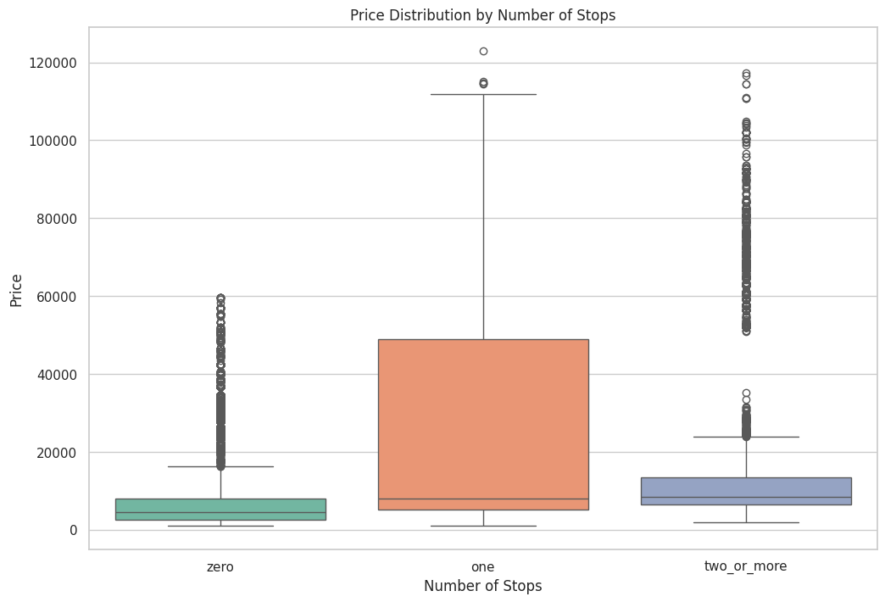

Slide 12
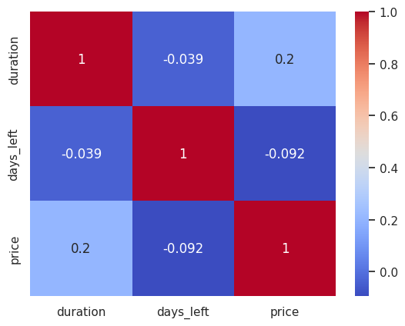
Corelation Plot

Slide 13
Architecture/Methodology Linear Regression
MAE: 4254.83 - Average deviation of predictions from actual values.
MSE: 38,409,361.97 - Indicates high variations in prediction errors.
RMSE: 6197.53 - Represents a high level of error.
R-squared: 0.9255 - Approx. 92.55% of the variance is predictable, suggesting good model performance despite high error metrics.

Slide 14
Decision Tree
MAE: 880.62 - Much lower than Linear Regression, indicating precise predictions.
MSE: 8,889,112.54 - Notable variance in prediction errors but lower than Linear Regression.
RMSE: 2981.46 - Significantly improved accuracy compared to Linear Regression.
R-squared: 0.9828 - Nearly 98.28% of the variance explained, showing excellent model performance.

Slide 15
Random Forest
MAE: 1438.97 - Higher than Decision Tree but much lower than Linear Regression.
MSE: 10,051,078.12 - Moderate error variance, better than Linear Regression but not as good as Decision Tree.
RMSE: 3170.34 - Better performance than Linear Regression, but not as precise as Decision Tree.
R-squared: 0.9803 - Explains about 98.03% of the variance, almost as effective as the Decision Tree.

Slide 16
Comparison and Conclusion
Accuracy: The Decision Tree model provides the most accurate predictions, followed by the Random Forest and then Linear Regression.
Consistency: Despite the Decision Tree having the lowest error metrics, Decision Trees are generally more prone to overfitting compared to Random Forests. The Random Forest model, which is an ensemble of decision trees, tends to provide more stable and consistent predictions across different datasets.
Model Fit: The R-squared value is very high for both the Decision Tree and Random Forest, indicating that they both capture the variability of the target variable very well. Linear Regression, while still showing a good fit (92.55%), is outperformed in terms of both error metrics and the proportion of variance explained.
Suitability: Decision Trees and Random Forests are more suitable for complex datasets where relationships between features are non-linear. Linear Regression, while useful for understanding relationships between variables, may not capture complex patterns as effectively as tree-based methods.

Slide 17
Results
The Decision Tree model demonstrated the greatest precision but also prompted worries about potential overfitting. Linear Regression offered important perspectives on linear relationships but was constrained by its assumptions and surpassed by more complex models in terms of error metrics. Meanwhile, the Random Forest model showcased a robust balance of accuracy and stability, proving effective in various scenarios and adept at managing complex, non-linear data structures.

Slide 18
References
https://stackoverflow.com/questions/
Lectures Notes

Slide 19
GitHub Repository for Code

Slide 20
THANK YOU

